Slide 1
TMDB movie data analysis
Here is where your presentation begins

Slide 2
Contents
Identify the columns that have null values and perform the null value treatment. (Choose the imputation method based on the type of data in the columns of interest)
Display the movie categories where the revenue is greater than $961,000,000.
List the top 10 movies with the highest revenues and the top 10 movies with the least budget.
How are popularities of movies related with the movie budgets? Are they correlated or totally uncorrelated with each other? Write the interpretation of your analysis.
Display the names of the top 25 production companies based on the number of movies they
Sort the data in descending order based on revenue and filter the top 500 movies. Find the measures of central tendency for the following columns using the filtered data
→ 1 budget2.
revenue3.
runtime
7. Perform outlier analysis for the above three columns using box plots

Slide 3
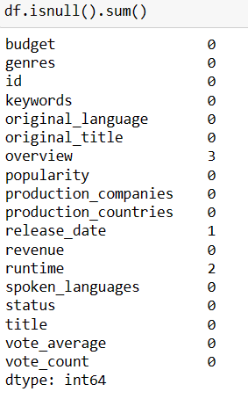
Identify the columns that have null values and perform the null value treatment. (Choose the imputation method based on the type of data in the columns of interest)
Forward Fill (ffill): Missing values were replaced with the most recent non-null value found before them in each column. This assumes values tend to remain consistent or have a trend within a column.
Backward Fill (bfill): Missing values were replaced with the closest non-null value found after them in each column. This assumes values might be influenced by later measurements or trends.
Threshold for Removal: Columns with over 50% null values were deemed unreliable or insignificant for analysis and were removed to enhance data quality and focus on informative features.

Slide 4
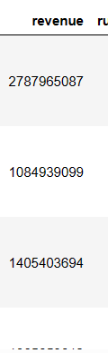
Display the movie categories where the revenue is greater than $961,000,000.
Code : df_r=df[(df['revenue']>961000000)]
df[]: Creates a new DataFrame named df_r, containing only the rows that meet the specified condition.
> 961000000: Applies a condition, filtering for only those rows where the value in the "revenue" column exceeds 961,000,000.

Slide 5
List the top 10 movies with the highest revenues and the top 10 movies with the least budget.
Code :
df_tr=df2.sort_values('revenue',ascending=False)[:10]
Code :
df_tb=df2.sort_values('budget',ascending=True)[:10]
Sorting: The code arranges the DataFrame by budget in ascending order, placing entries with smaller budgets at the top.
Slicing: It extracts the first 10 rows from the sorted DataFrame, effectively isolating those with the lowest budgets.

Slide 6
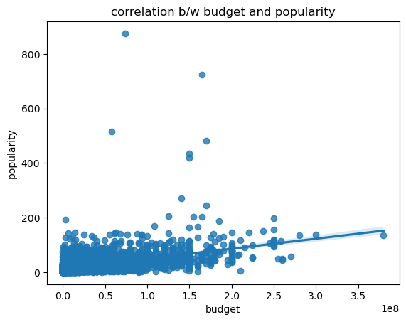
How are popularities of movies related with the movie budgets? Are they correlated or totally uncorrelated with each other? Write the interpretation of your analysis.
Code : plt.xlabel('budget')
plt.ylabel('popularity')
plt.title('correlation b/w budget and popularity')
sb.regplot(data=df2,x='budget',y='popularity')
plt.show()
as fig shows the popularity and budget have the positive relation with each other

Slide 7
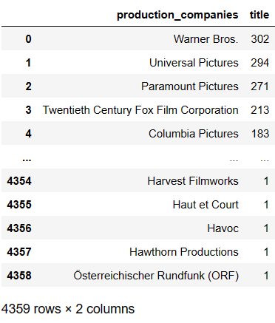
Display the names of the top 25 production companies based on the number of movies they
Code :
df3.groupby('production_companies')['title'].count().sort_values(ascending=False).to_frame().reset_index()

Slide 8
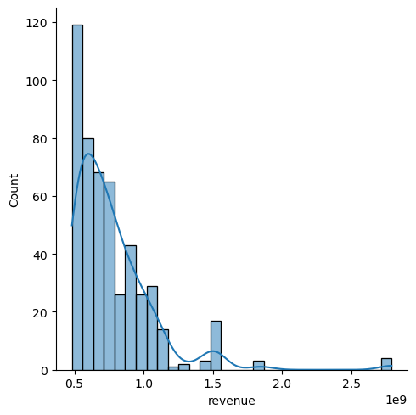
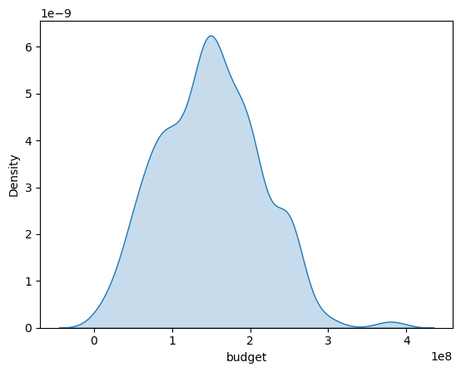
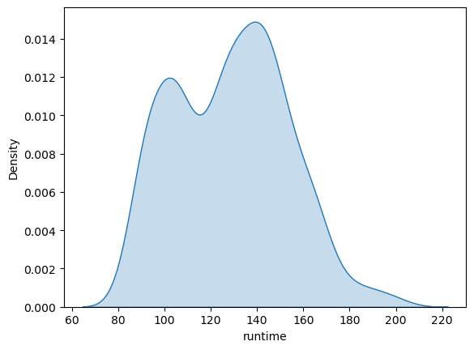
Sort the data in descending order based on revenue and filter the top 500 movies. Find the measures of central tendency for the following columns using the filtered data1.
Code:
sb.displot(df5.revenue,kde=True);
sb.kdeplot(data=df5,x='budget',fill=True)
plt.show()
sb.kdeplot(data=df5,x='runtime',fill=True)
plt.show()

Slide 9
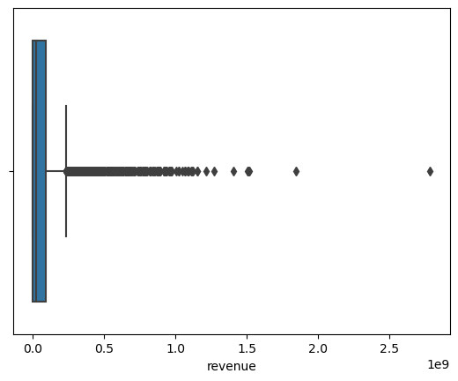
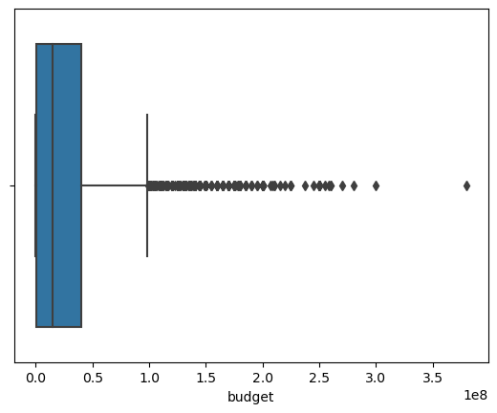
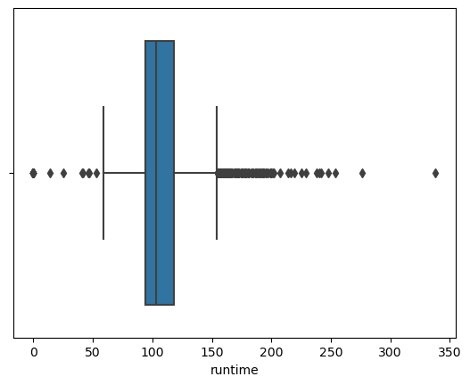
Perform outlier analysis for the above three columns using box plots
Code :
sb.boxplot(data=df,x='revenue’)
sb.boxplot(data=df,x='budget’)
sb.boxplot(data=df,x='runtime’)

Slide 10
Thank youu

